Slide 1
FINAL PROJECT
Causes of Death over the World
Submitted By: Yashasvi Sharma, Anshul Jaiswal
Submitted To:
Michail Xyntarakis

Slide 2
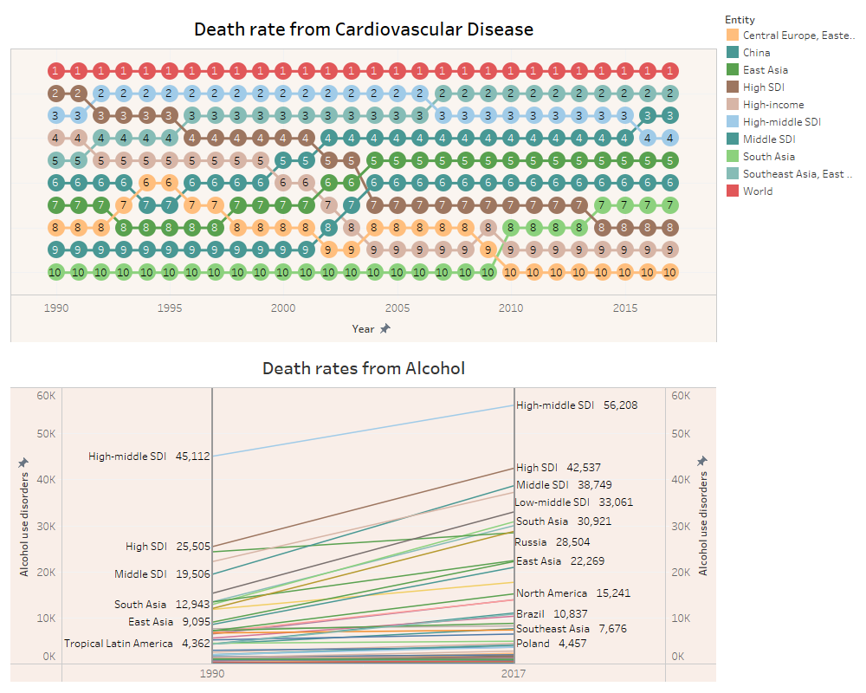
Causes Of Death
Causes of Death involves various factors.
Factors focused on the project are:
1. Cardiovascular Disease
2. Alcohol Consumption
Major contributors to the death counts all
over the world.

Slide 3
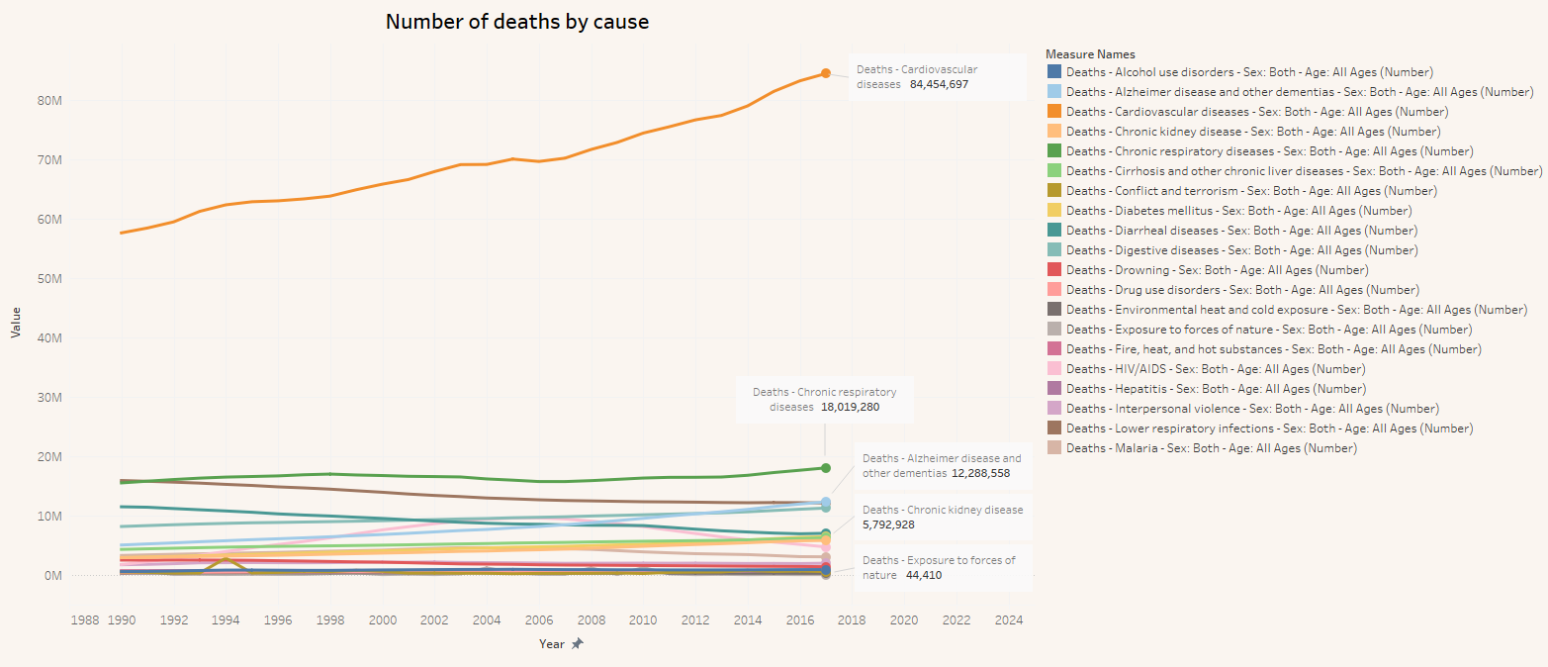
Connected Scatterplot represents the number of deaths by various causes ranging from diseases to natural forces.
Highest number of deaths were reported by cardiovascular diseases.
Lowest number was due to Exposure to forces of nature.

Slide 4
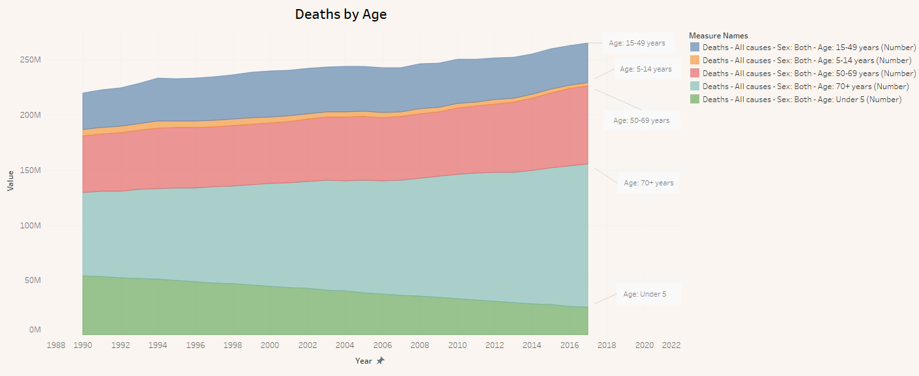
Area graph representing the deaths within different age groups in the span of 17 years from 1990 – 2017.
The maximum death count is in the age group of 70+ years which is eventually increased with time.
The minimum death count is measured in the age group of 5 – 14 years.
Age group under 5 represents a downfall in death count over the years.

Slide 5
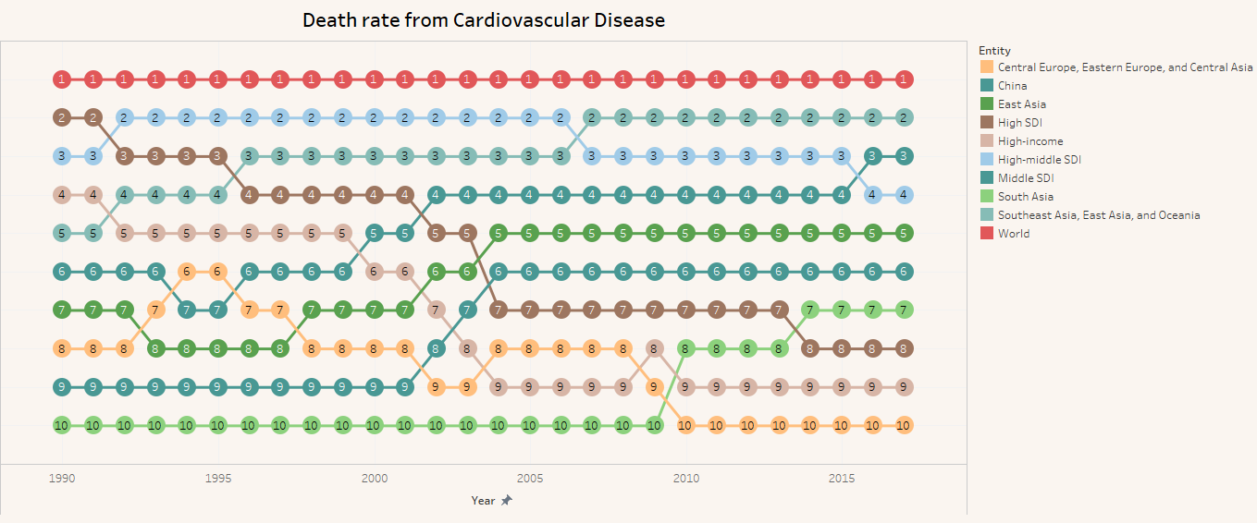
Bump chart representing the Death rate from Cardiovascular Disease in various regions and segments of the world based on their rank in the death rate count.
We can clearly see the variations in the rank of different factors as we move from year 1990 – 2017.

Slide 6
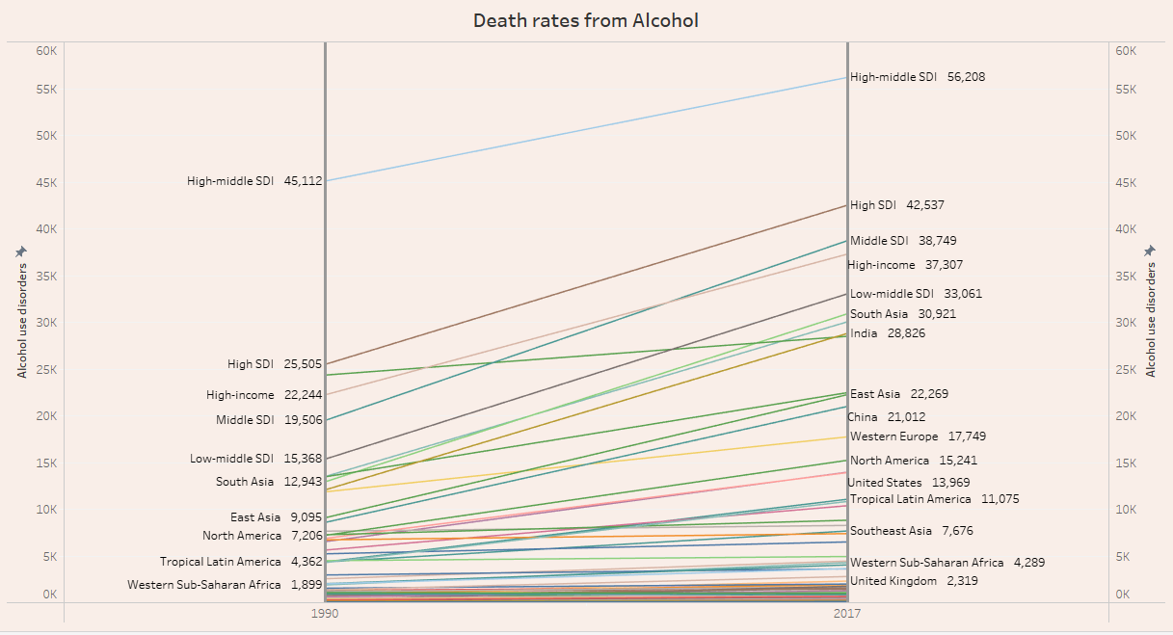
Slope Graph provides information about the Death rates in the world from Alcohol consumption in year 1990 - 2017.
The number have seen a significant increase in 2017 as compared to 1990.

Slide 7
Conclusion
An increase in the death rate from year 1990 to year 2017 significantly around 25 - 30 million.
Cardiovascular diseases stands on the top with maximum count for the death rate.
Death count and are increasing over years for each age group except under 5.

Slide 8


